Slide 1


19th Annual Family CAFÉ Conference 2017
Rick Scott
Governor
Barbara Palmer
Director
Notes:
Good Afternoon Everyone. I’m Rhonda Sloan, the CDC+ Administrator, the Agency for Persons with Disabilities. I am also a Representative for my daughter who has been on the CDC+ Program since 2001, I live the program each day and hope that you will find this presentation very informational and help you determine if the CDC+ program is right for you. How many people in the audience are already on the program? Or on the waiting list? Let’s begin

Slide 2

Presentation Overview
What is the CDC+ Program?
Description
Responsibilities
Updates
2
Notes:
This presentation will provide information about the CDC+ Program, Responsibilities and Updates.

Slide 3
CDC+
Began in 2000 - research-Consumer-Directed Care (CDC)
January 2004 - Consumer-Directed Care Plus (CDC+) demonstration phase
March 2008 - CDC+ became a permanent Florida Medicaid State Plan Option
As of May 1, 2017, a total of 2,864 consumers are actively managing their CDC+ funds
3
Notes:
The CDC+ Program began in 2000 as an 8-year research and demonstration project called Consumer Directed Care (CDC)
In January 2004, (after three successful years as a research project) CDC was expanded and entered the demonstration phase called, Consumer-Directed Care Plus (CDC+).
In March 2008 CDC+ was offered as a permanent Florida Medicaid State Plan.
Currently there are a total of 2,864 consumers self-directing their supports and services. Between 30 – 45 new enrollees each month
There is no cap on the number of consumers that can be enrolled in CDC+..

Slide 4


What is CDC+ All About?
Long-term care program alternative to the DD/HCBS waiver
Principles of self-determination
Person-centered planning
Participant-driven
4
Notes:
CDC+ is a long-term care program alternative to the Developmental Disabilities / Home and Community Based Services (DD/HCBS) Medicaid Waiver.
CDC+ is based on the principles of self-determination along with person-centered planning that provides the opportunity to improve the participant’s quality of life.
CDC+ is participant-driven. This means the consumer is in the drivers seat and is expected to be involved in all aspects of planning for their supports and services

Slide 5
Self-Determination and
Person-Centered Planning
FREEDOM
AUTHORITY
SUPPORT
CONTROL
RESPONSIBILITY
5
Notes:
There are five principles of Self-Determination.
FREEDOM to decide where and with whom an individual lives.
AUTHORITY to decide how the individual will live his or her life.
SUPPORT the individual’s need to make decisions.
CONTROL over the resources needed for an individual’s support.
RESPONSIBILITY for an individual’s decisions and actions.

Slide 6
The Participant Controls
WHAT
WHO
WHEN
WHERE
HOW
6
Notes:
In the CDC+ program the participant is in charge of…
WHAT supports and services are purchased
WHO provides the supports and services
WHEN supports and services will be provided and the quantity
WHERE supports and services will be provided AND
HOW supports and services will be provided

Slide 7
Comparison of Waiver vs. CDC+ Program
CDC+ Program Services
(8% + 4% = 12% reduced budget)
iBudget FL services PLUS…
  Advertising
  Seasonal Camp
  Gym Membership
  Over the Counter Medications
  Personal Emergency Response
  Parts & Repair
  Therapeutic Equipment
  Specialized Training
  Other Therapies
  *** Accumulate unencumbered funds for these services or additional hours
iBudget FL - Medicaid Waiver
Seven (7) Service Families
  Life Skills Development
  Supplies & Equipment
  Personal Supports
  Residential Services
  Therapeutic Supports
  Transportation
  Dental
  *** must use Medicaid Waiver providers and established rates
7

Slide 8

Steps to Enrolling in the CDC+ Program
Enroll in DD/HCBS iBudget waiver
Live in own home or family home
Take CDC+ training
Pass Readiness Review with score of 85% or better
Select a Waiver Support Coordinator trained to be CDC+ consultant
8
Notes:
Are you eligible for the CDC+ Program?

Slide 9
Steps to Enrolling in the CDC+ Program
Fill out application/enrollment packet
  2-page Application
  IRS forms 8821 & 2678
  Fiscal Informed Consent
  Direct Deposit for Consumer or Representative
***this application/enrollment process will take at least 45 days or more
9
Notes:
Are you eligible for the CDC+ Program?

Slide 10
Steps to Enrolling in the CDC+ Program
Budget Authorization Form is received with CDC+ Consumer ID# and the monthly budget
Begin to interview and make decision on potential employees
  Have employees complete appropriate employee or vendor packet
Enroll in background screening Clearinghouse, initiate screenings on employees
Write your purchasing plan
10
Notes:
The CDC+ State Office will send to your consultant a BAF with identifies the Consumer ID# and the monthly budget
Make the decision on who you will hire
Employee packet or vendor packet
Enroll in Background screening clearinghouse, initiate screenings on employees.
You are now ready to write your purchasing plan

Slide 11


CDC+ Monthly Budget
DD/HCBS iBudget Waiver cost plan
Monthly services approved on cost plan are divided by the number of months authorized on cost plan; cost plan amount
  Discount rate applied
  Administrative fee applied
Flexible CDC+ monthly budget
11
Notes:
A CDC+ participant’s monthly budget is based on the cost of services that a participant has been approved to receive in the DD/HCBS waiver Cost Plan.
Annual services are divided by the number of months authorized. The amounts are totaled to determine the total monthly Cost Plan amount.
A discount rate and administrative fee are subtracted from the Cost Plan total.
Based on this method the CDC+ Participant exchanges the total budget of their current approved, Medicaid waiver Cost Plan for a smaller budget that has greater flexibility.

Slide 12
Building Blocks of a
CDC+ Purchasing Plan
Support Plan Cost Plan
Purchasing Plan
12
Notes:
Lets build on what we know:
The Support Plan documents the Participant’s current needs and goals for services and support and is used to build the Cost Plan which details the allowed maximum spending for each waiver service.
A participant’s monthly budget is calculated from the current approved cost plan.
When the monthly budget has been determined using the Cost Plan a Purchasing Plan can be completed.
When the Purchasing Plan has been approved by APD, the participant may begin managing the CDC+ monthly budget

Slide 13
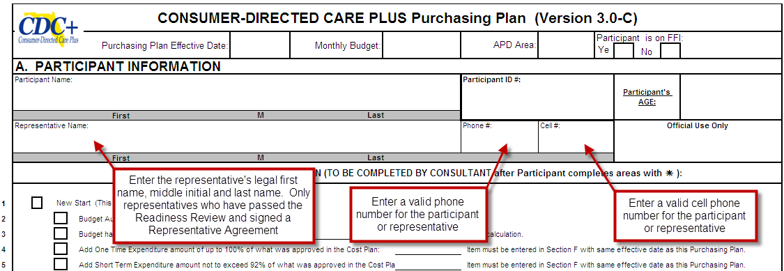
Purchasing Plan (version 3.0-C)
Purchasing Plan Development
13
Notes:
Use current version 3.0C when developing your Purchasing Plan.

Slide 14
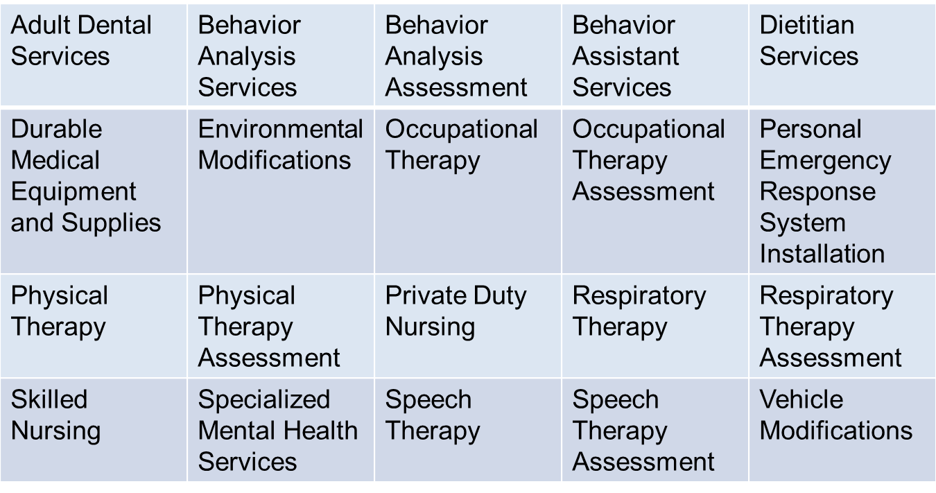
Services
Notes:
Some services are restricted in the way the funds can be utilized and some are not.
You consultant will assist you to identify those that apply to you

Slide 15
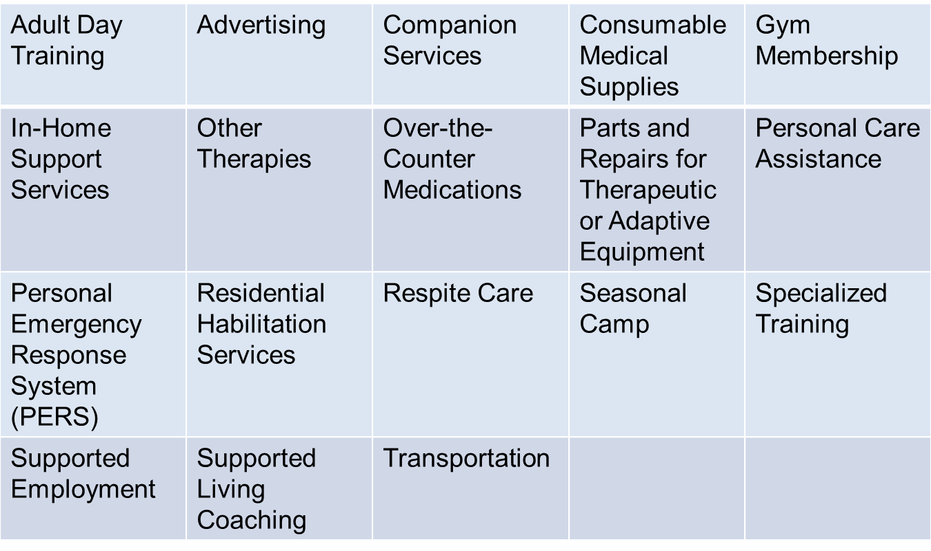
Services(continued)

Slide 16

Roles and Responsibilities
Roles: Participant, Representative
Consultant, Liaison, and Fiscal Employer Agent
16
Notes:
Roles and responsibilities of the CDC+ program Participant, Representative, Consultant, Liaison and Fiscal Employer Agent

Slide 17


Participant Responsibilities
Develop Purchasing Plan
Write job descriptions, train, and negotiate pay
Hire, manage, and terminate providers
Ensure background screening requirements are met
Be authorized signer of program documents
Responsible for managing the Medicaid funds provided to the participant
Cooperate with Quality Assurance Monitoring
17
Notes:
Consumer, participant and representatives terms are used interchangeable if a consumer/participant has a representative
Participants are expected to:
Develop a Purchasing Plan and ensure it remains updated
Write a job description for each service provider or individual who is hired for the job and provide training as required
As a household employer- negotiate rates, hire, pay, manage, terminate providers and ensure background screening requirements are met.
Sign all program documents, for example, provider timesheets and invoices and tax documents.
Use the CDC+ Monthly Budget responsibly to meet the identified long-term care needs and goals; purchase only approved services and supports; do not overspend the monthly allowance
And cooperate with the Quality Assurance process Docs must be maintained for 6 years.

Slide 18



The Representative
Must be 18 years of age
Cannot be
Paid
or
Benefit from any business authorized to provide services for the participant
18
Notes:
The representative of the Participant enrolled in the CDC+ program will assist the Participant in implementing self-direction of budget allowance and approved CDC+ services
CDC+ representatives must be at least 18 years of age.
CDC+ representatives, should be intimately involved in the participant’s life and support their wishes and needs by making the best choices for them.
CDC+ representatives cannot be paid or be a paid employee that provides any other service.
CDC+ representatives cannot be an owner, co-owner, stockholder, president, vice president or in any way benefit from any business authorized to provide services to or for the participant.

Slide 19


Consultant Roles
Review support plans
Ensure Medicaid eligibility
Provide information, support, and technical assistance
Monitor health, safety, and welfare
Report neglect, abuse, or exploitation
Make monthly contact and bi-annual face-to-face visit
19
Notes:
The CDC+ consultant has an active role in the participant’s annual support planning process and ensuring Medicaid eligibility.
The CDC+ consultant should provide information, support and technical assistance as needed for matters such as choosing supports and services to meet the participant’s needs and goal and in planning for their future needs.
They will also monitor the participant’s health, safety & welfare and immediately report any instance of neglect, abuse or exploitation.
Having monthly contact with the Participant in the form of phone calls or in person, whichever is the Participant’s preferred method, is a great way to assess the participant’s well-being.

Slide 20



Regional CDC+ Liaison Role
APD employee
Primary contact person for the Region in the CDC+ Program
Oversee local program operations
20
Notes:
The Area CDC+ Liaison is employed by the Agency for Persons with Disabilities and is the contact person at the local level for CDC+ Program.
The Area Liaison will oversee local program operations,.

Slide 21




CDC+ State Office
Administer the CDC+ Program
Develop and interpret policy
Quality Assurance Monitoring
Fiscal and payroll duties
Provide customer service and technical assistance
Develop and update CDC+ training materials
21
Notes:
The CDC+ State Office is located at the APD State Office in Tallahassee.
Staff coordinates with AHCA (the Agency for Health Care Administration) in the development of all policies and procedures for the administration of the CDC+ program and ensures that all state and federal required guidelines, policies and procedures are followed, which includes quality assurance and monitoring.
The State Office performs all the fiscal and payroll duties
Provides customer service including on-going technical assistance to the participant, representative and consultant, by answering questions and providing explanations.
Develop and update CDC+ training materials for consumers, representatives, consultants and CDC+ Regional Liaisons
Conduct initial and ongoing CDC+ training for consumers, representatives, consultants and CDC+ Regional Liaisons

Slide 22



Fiscal / Employer Agent (F/EA)
Requests and receives monthly budget
Assigns provider ID number
Provides banker, bill payer, and tax payer services
Sends monthly statements
22
Notes:
The Fiscal Employer Agent (F/EA) receives the participant’s monthly budget amount from Medicaid and maintains it in the participant’s account.
The F/EA assigns CDC+ Provider ID numbers and provides banker, bill payer and tax payer services.
Monthly statements are sent by the F/EA to the participant showing the amount of money that was deposited each month, the purchases that were made, and the ending balance of the participant’s account at the end of the statement month.
***It is the participant’s responsibility to reconcile their CDC+ statement monthly and immediately report any discrepancies to APD CDC+ fiscal staff.

Slide 23

Background Screening Procedure
  New screening method as of May 25, 2015, via Care Provider Background Screening Clearinghouse
  To pre-register and log onto: https://apps.ahca.myflorida.com/SingleSignOnPortal
  Background Screening will be initiated once rep registers
Fingerprints and photo of employee will be retained
5 year rescreening will be less expensive
Representative receives alerts via their email
23
Notes:
Effective August 1, 2010, a successful Level 2 Background Screening is required for all new service providers prior to beginning work. This includes all minors and emergency back-ups (EBU’s) who are listed on a Purchasing Plan as natural support. Per the law, there are no exceptions.
Background screening expenses are the responsibility of the provider, not the participant or representative. Medicaid or CDC+ funds cannot be used for screening or rescreening providers.
Background screenings are valid for five (5) years.
Existing providers with Level 1 Background Screening must pass a Level 2 Background Screening prior to their Level 1 expiration date.
When time for rescreening, allow enough time to process the screening prior to the expiration date.
The employment/Contractor Roster must be maintained in the clearinghouse – brought some handouts

Slide 24
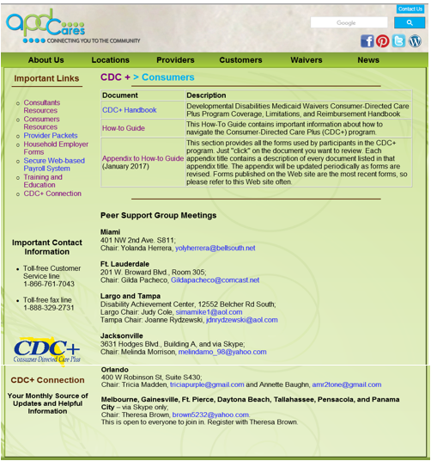
http://apdcares.org/cdcplus/consumers
  Program Toolbox
  CDC+ Rule Handbook
  CDC+ How-To Guide
  Appendix to the How-to Guide
24
Notes:
The CDC+ Program Participant Toolbox
The apdcares.org/cdcplus website provides a link for the CDC+ Rule Handbook, the How-To- Guide as well as a link for the Appendix to the CDC+ Participant Notebook
These resources are the guidebooks for the CDC+ program. Every consultant needs to be aware of the information contained in each. It is advisable for consultants to bookmark this site for quicker access when needed (e.g. when providing technical assistance to consumers/representatives).

Slide 25



Peer Support Groups in your Area
Miami
Ft. Lauderdale
Largo, Tampa
Jacksonville
Orlando
Melbourne, Gainesville, Daytona Beach, Tallahassee, Pensacola, and Panama City
  Networking
  Resources
  Join NOW!
25
Notes:
There are currently 6 Peer support Groups
Once the new trainer is in place – July 1
A Peer support group is ran by the members

Slide 26


Q & A Session and
Future Enhancements
26
Notes:
You can also list your questions on the index cards and I will get back to you.

Slide 27

Thank You
Customer Service is available Monday through Friday (8 A.M. – 5 P.M. EST), excluding state holidays.
CDC+ Customer Service 1-866-761-7043
Rhonda Sloan, CDC+ Administrator
Rhonda.Sloan@apdcares.org, 850-414-5070
Patricia Rush, Program Administrator
Patricia.Rush@apdcares.org, 850-413-6694
27

